Slide 1
NEO4J CYPHER TUTORIAL WITH PYTHON
Json To Neo4j Graph Using Cypher ,Apoc & Python
Tutorial 87

Slide 2
Sample json
{name: "DS101", subjects: ["coding", "data_structure", "algorithm"], duration: 1}
{name: "DS102", subjects: ["coding", "data_structure", "algorithm","system_design"], duration: 2}
{name: "DS105", subjects: ["ml", "ai", "algorithm","system_design"], duration: 2}
{name: "DS106", subjects: ["ai", "project_assigment", "industry_automation","system_design","viva"], duration: 3}

Slide 3
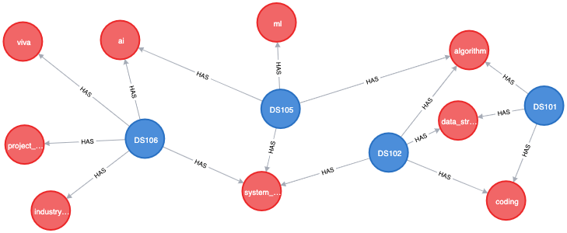
Expected graph

Slide 4
Use case
How To Create Graph From Json In Neo4j Using Cypher using apoc procedure

Slide 5
Pre-requisites
apoc.import.file.enabled=true
apoc.import.file.use_neo4j_config=false

Slide 6
Load multiple csv files using apoc procedures
call apoc.load.json("file:///users/roni/json_data/sample.json")
yield value
merge(a:Exam{NAME:value.name})
with a,value
unwind value.subjects as subject
merge(b:Subject{NAME:subject})
merge (a)-[:HAS]->(b)
Code written in neo4j browser

Slide 7
output
From neo4j browser

Slide 8
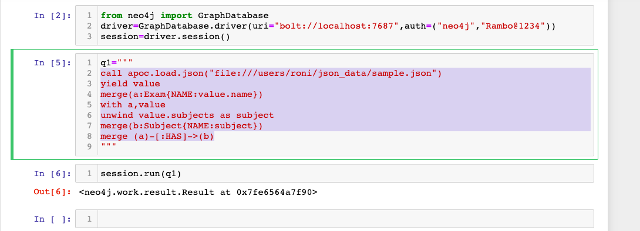
Load multiple csv files using apoc procedures
Code written in python ide

Slide 9
output
From python ide

